Slide 1

AIRLINE MANAGEMENT SYSTEM
- PRIYANKA RAO

Slide 2
AIRLINE MANAGEMENT SYSTEM
INTRODUCTION
The Airline Reservation System is a desktop-based application developed using Java Swing and MySQL, designed to simplify the process of booking airline tickets. This project simulates the core functionalities of a real-world airline system, including user authentication, flight search, booking confirmation, and ticket generation. It provides a seamless and intuitive interface for both administrators and users, aiming to enhance the overall booking experience through efficient data management, and ease of access.

Slide 3
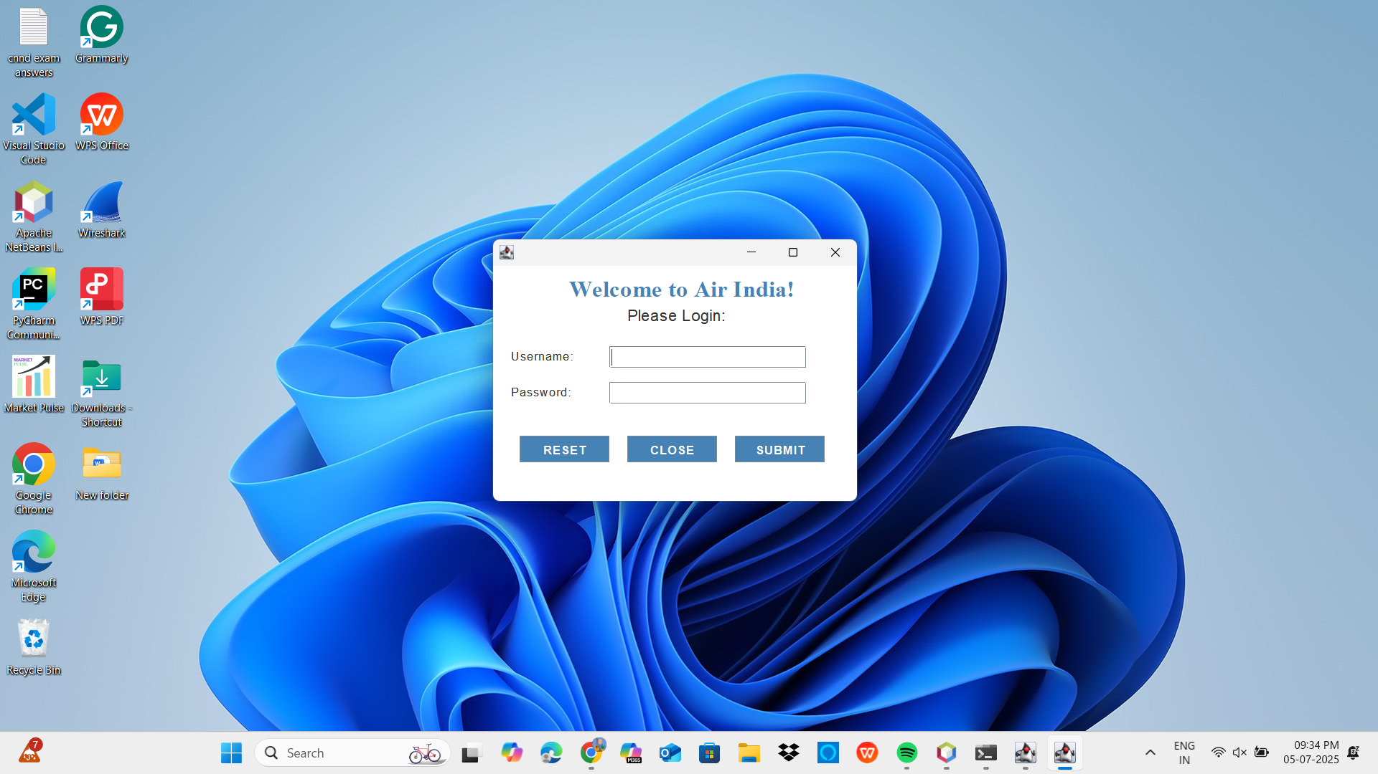

Slide 4


Slide 5
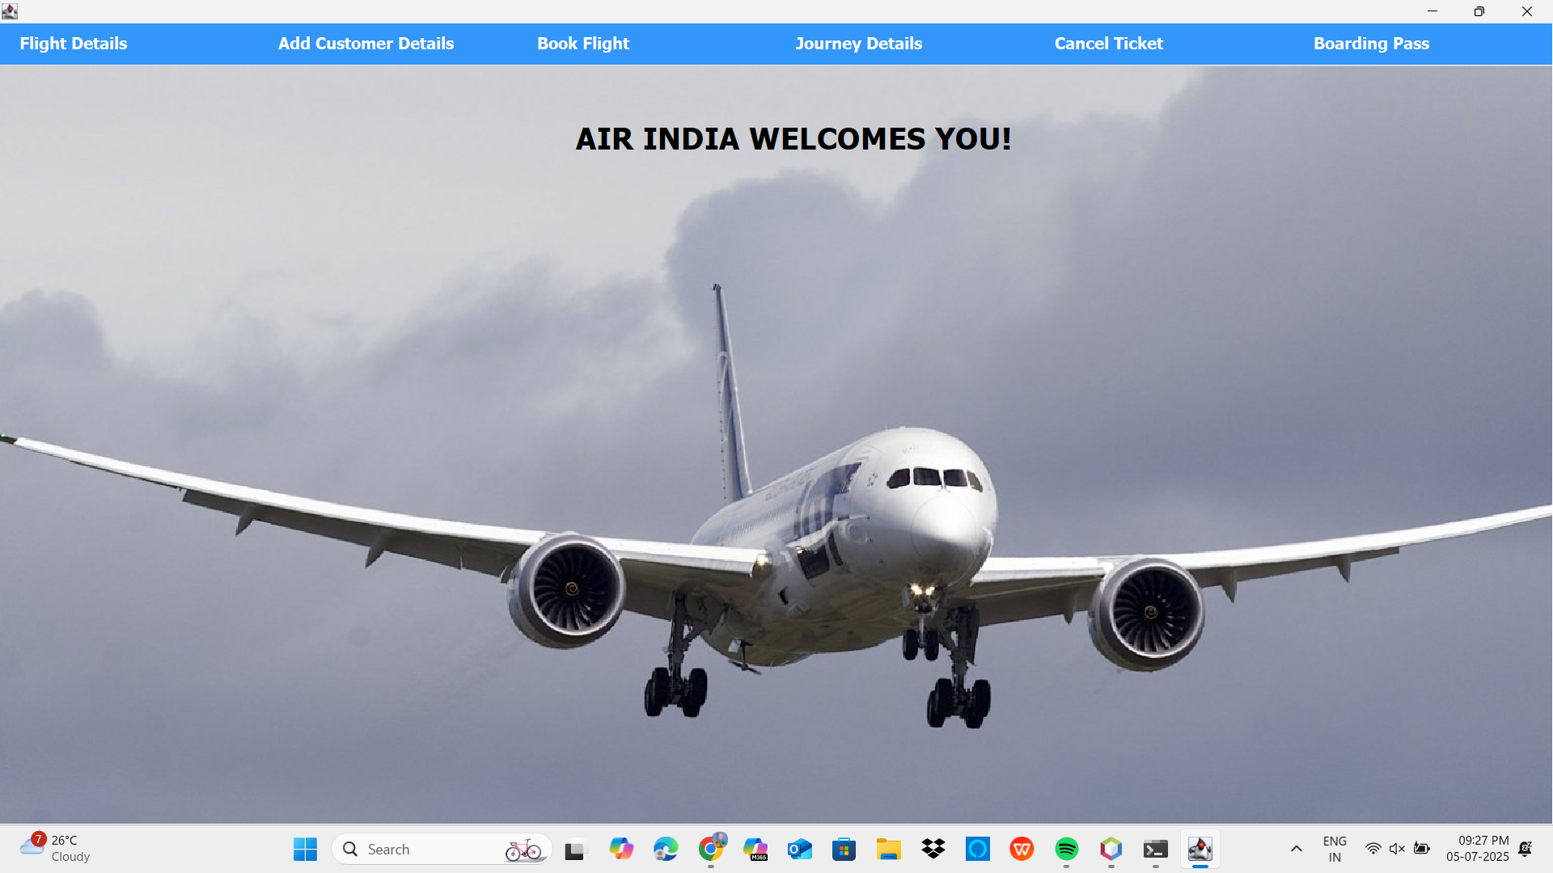

Slide 6
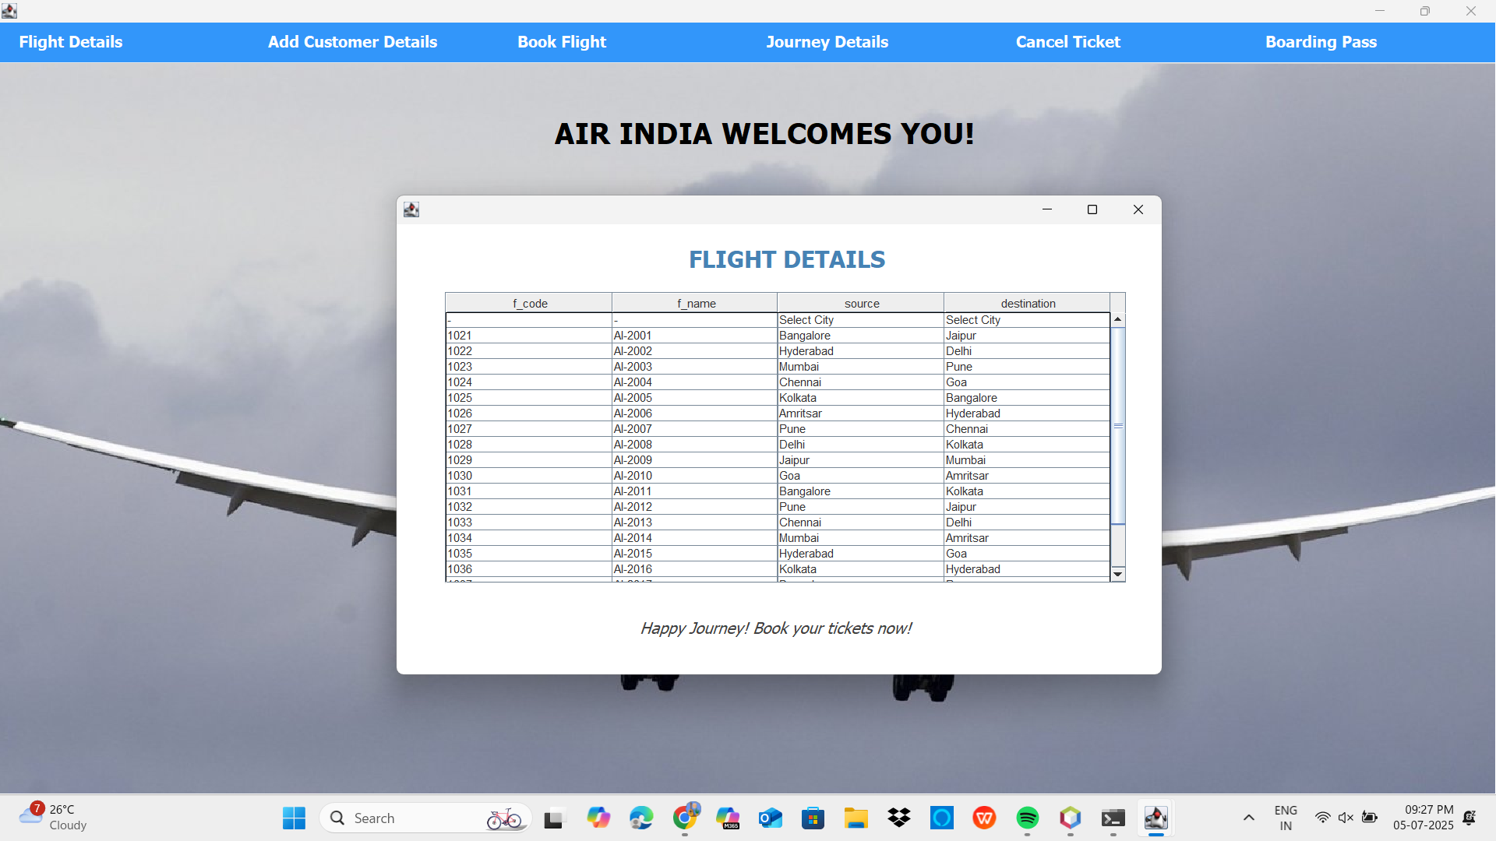

Slide 7
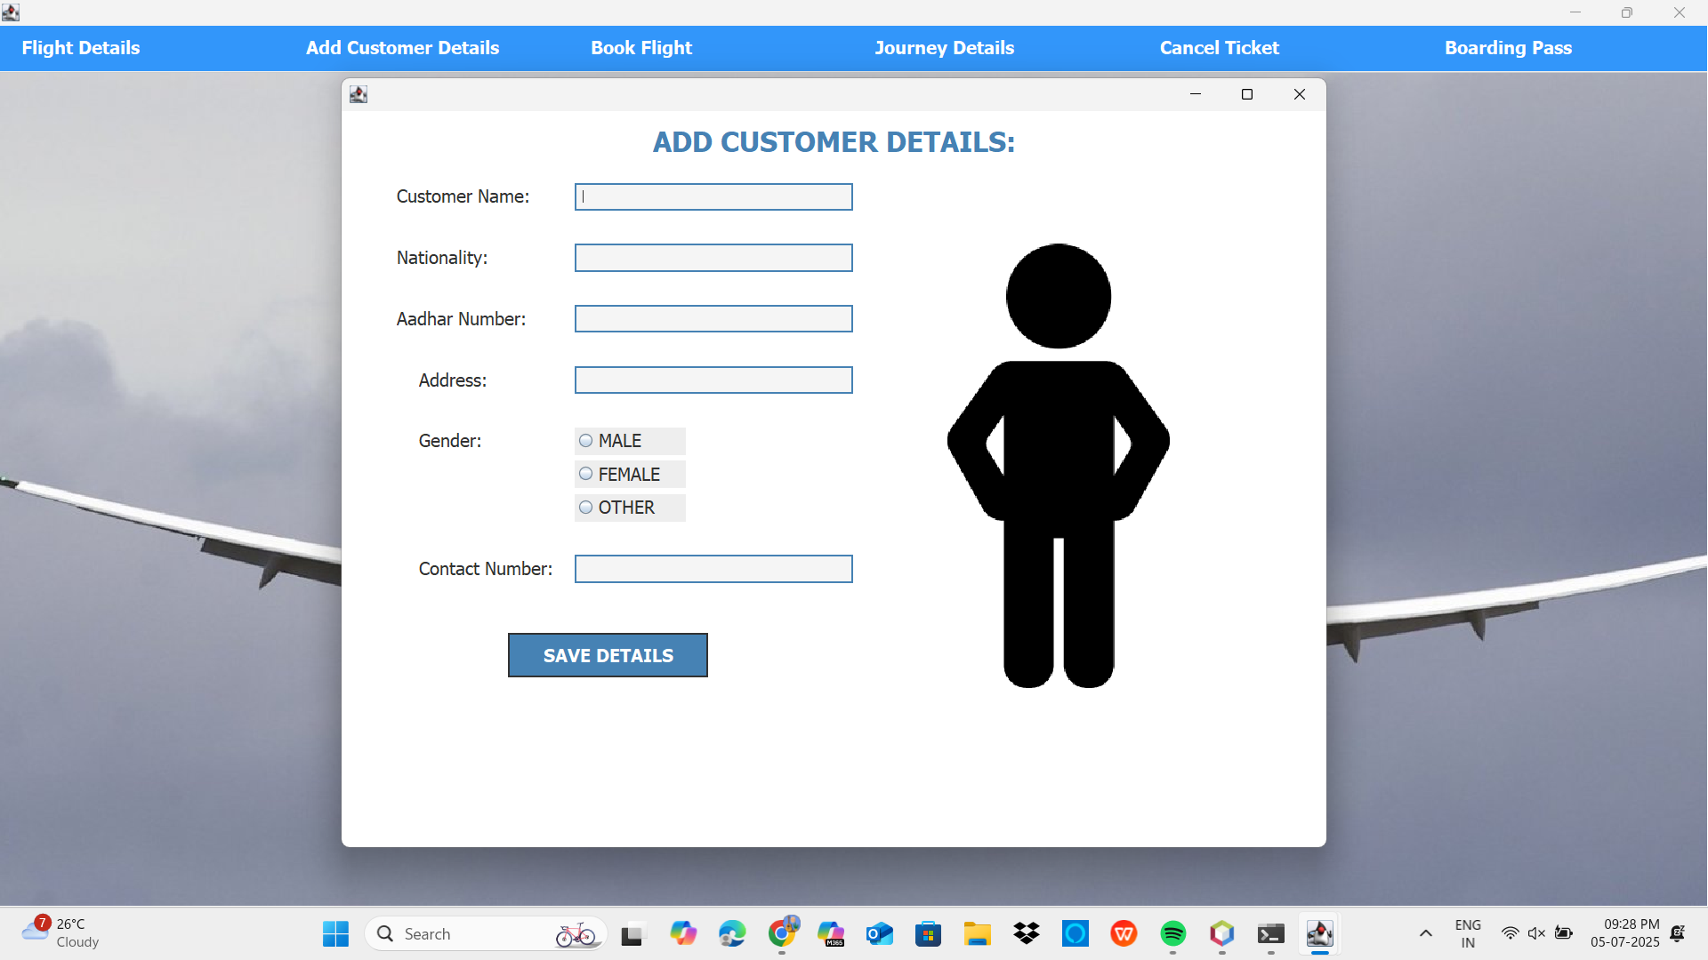

Slide 8


Slide 9
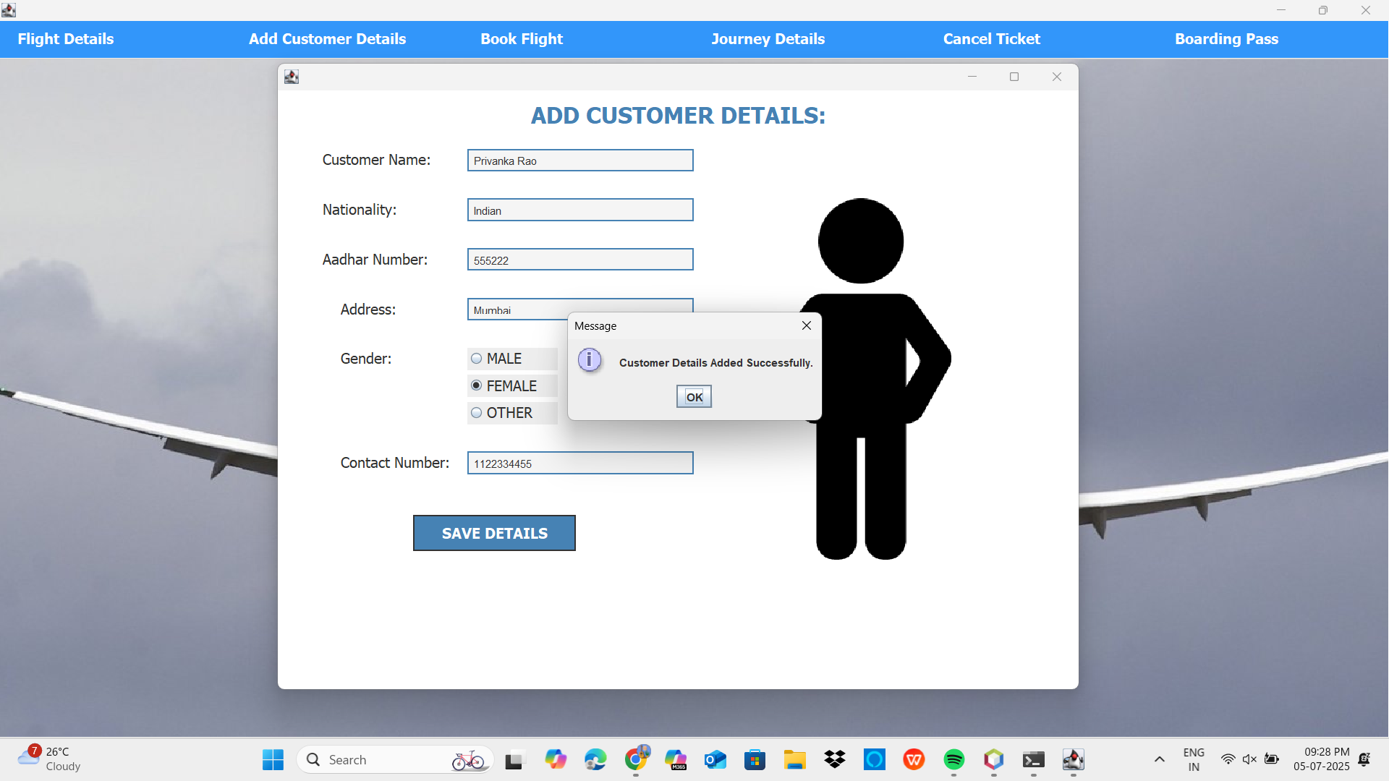

Slide 10
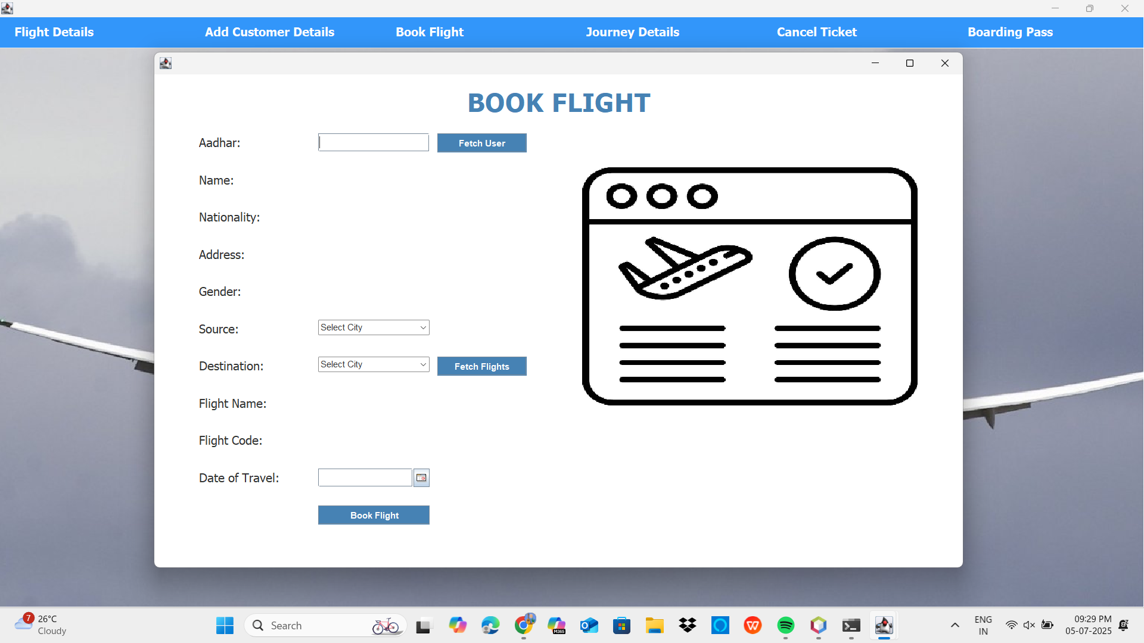

Slide 11
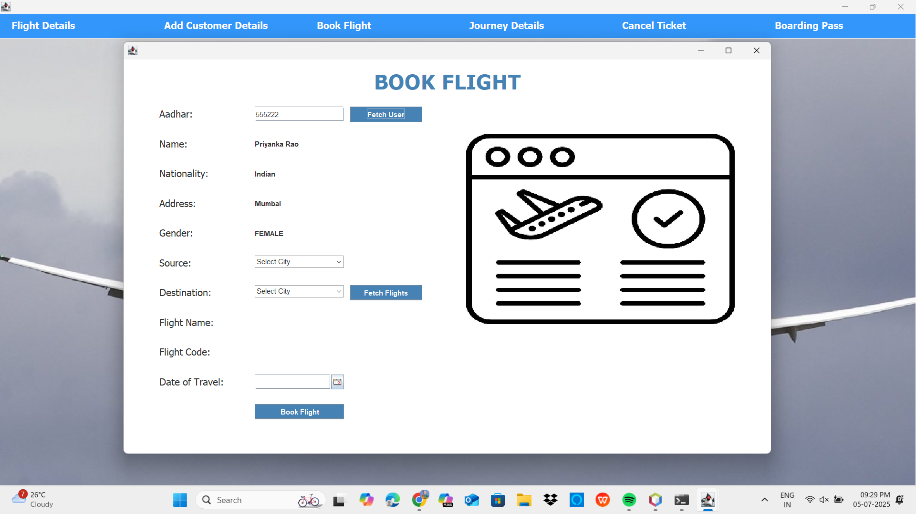

Slide 12
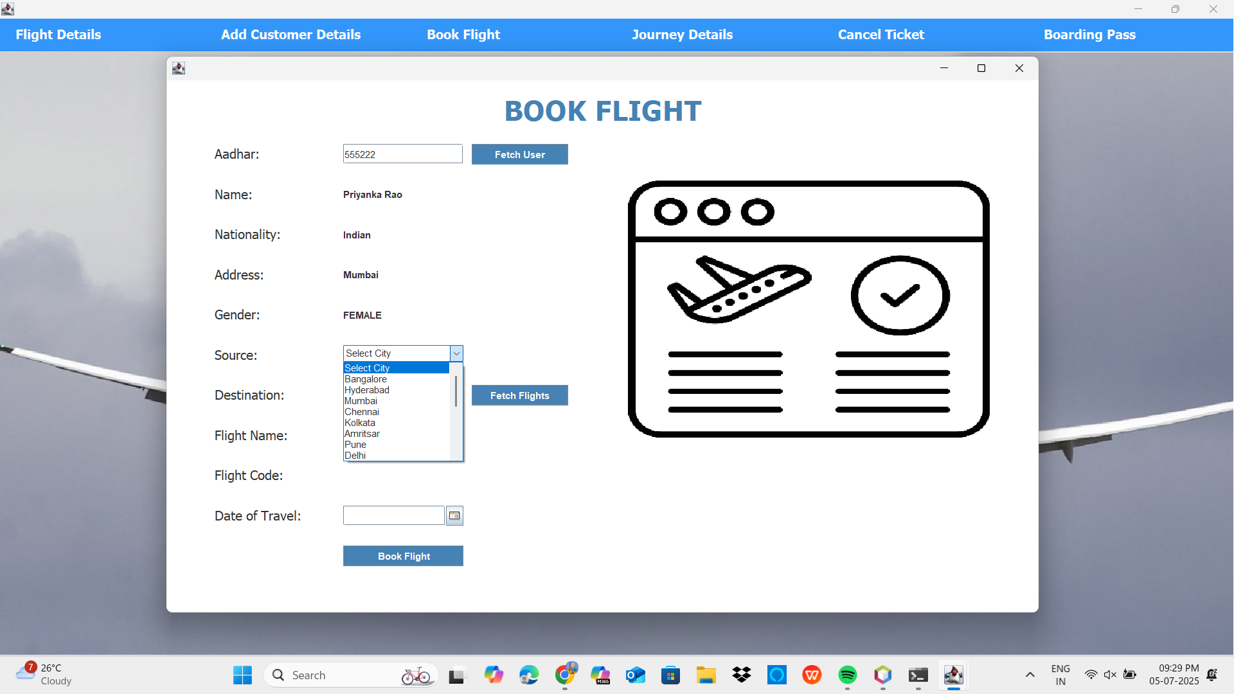

Slide 13


Slide 14
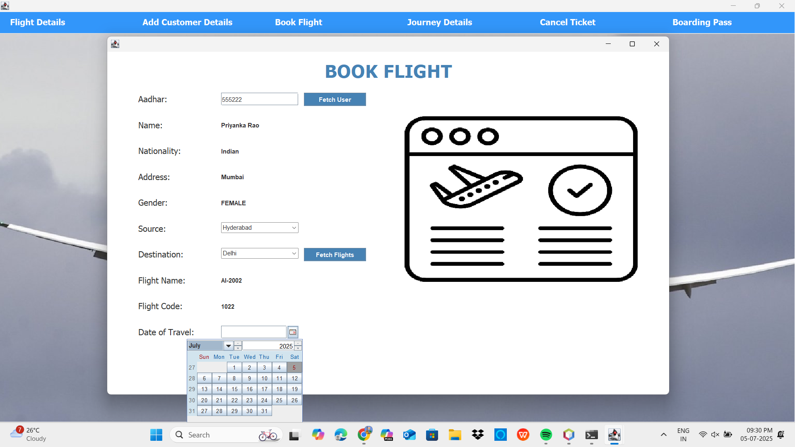

Slide 15


Slide 16
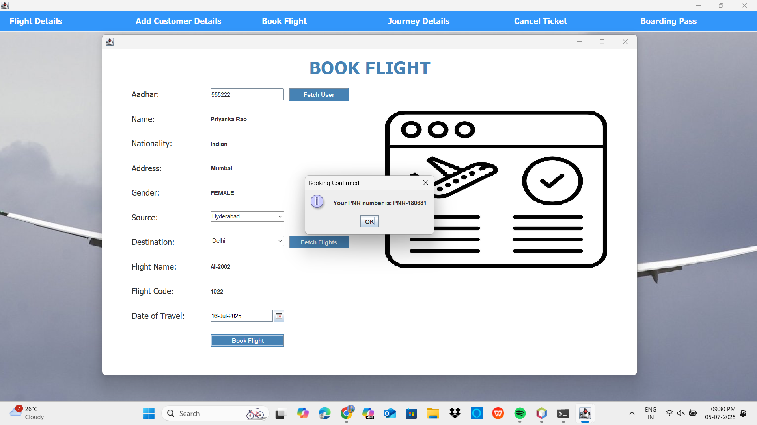

Slide 17
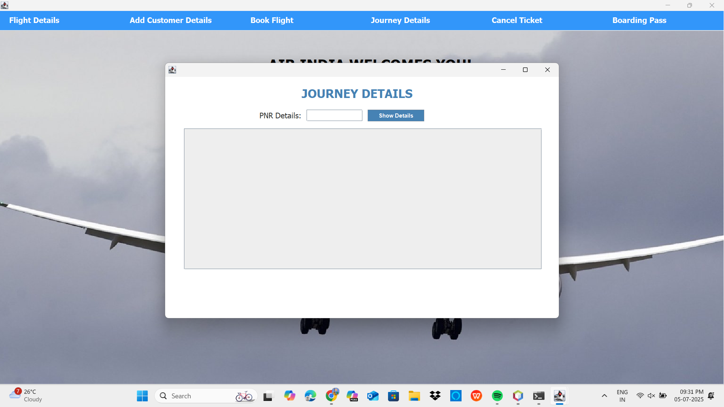

Slide 18


Slide 19
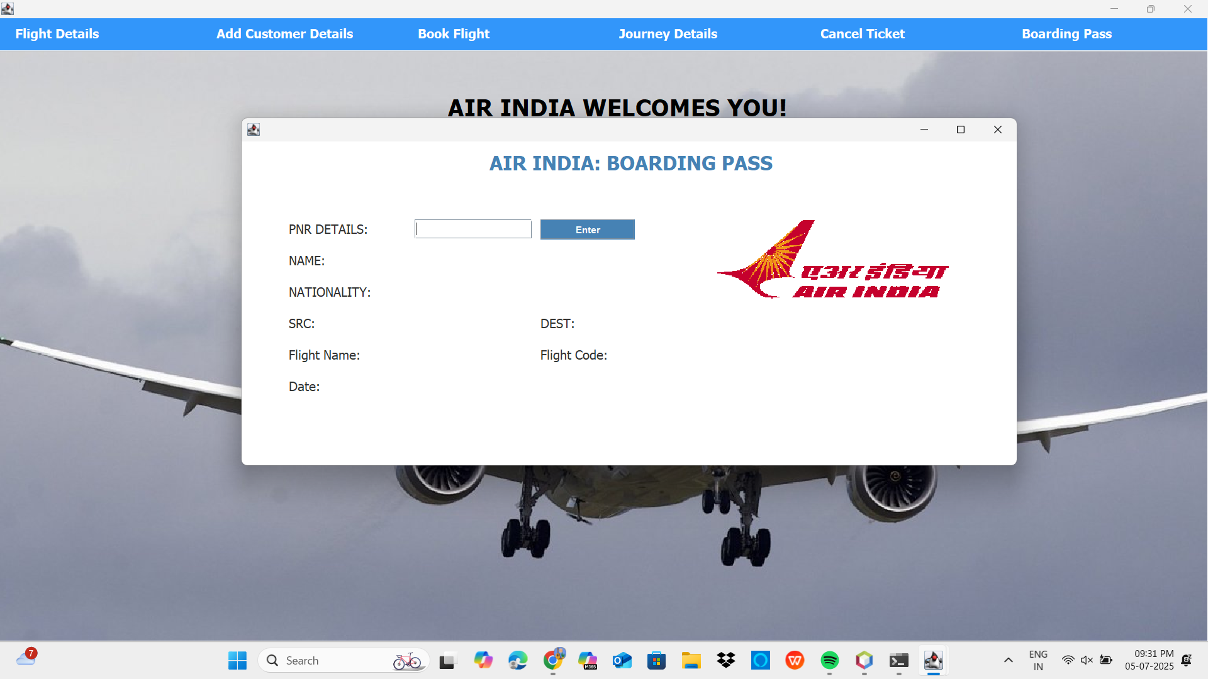

Slide 20
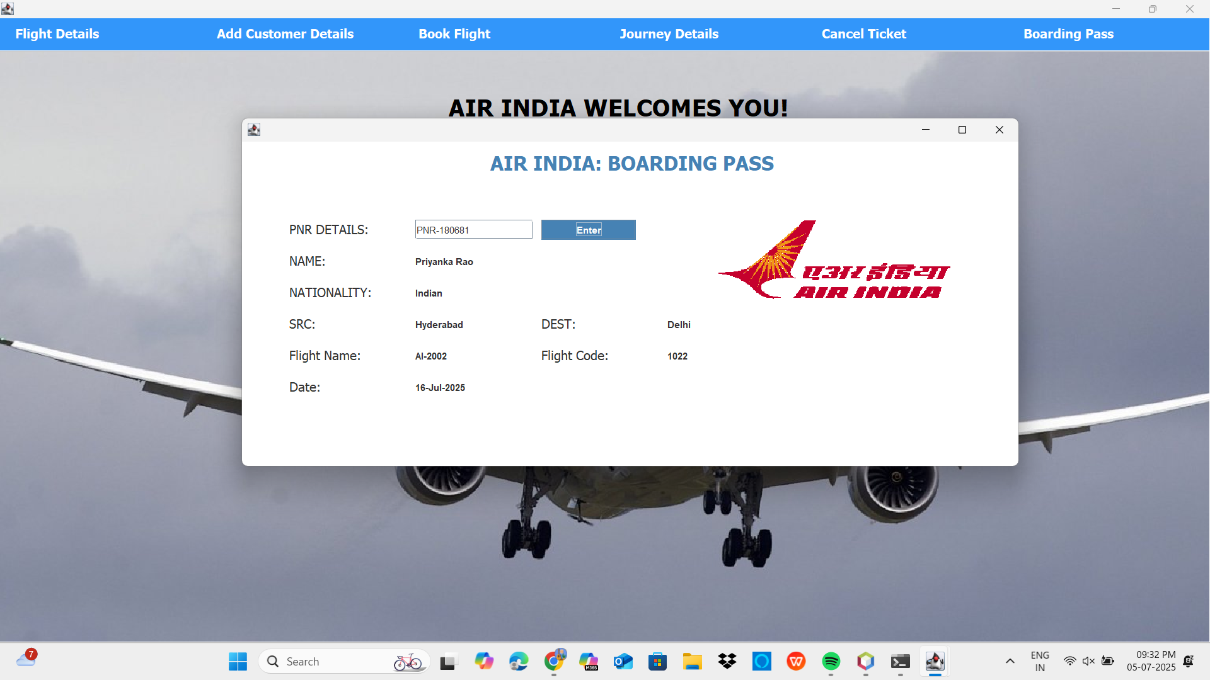

Slide 21
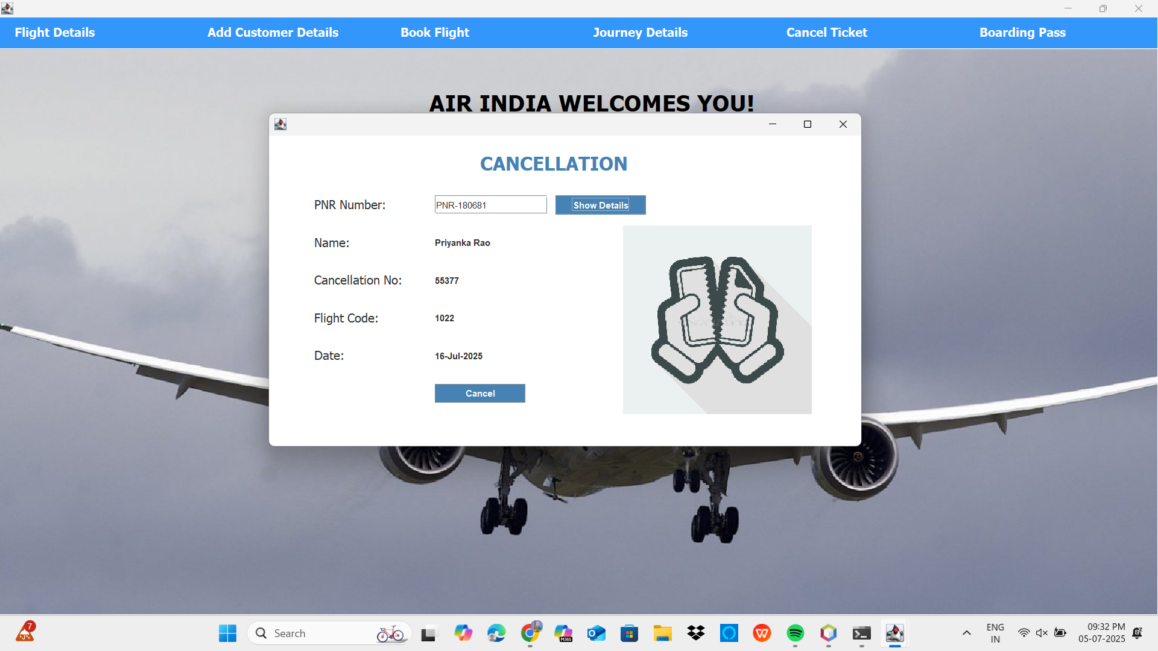

Slide 22
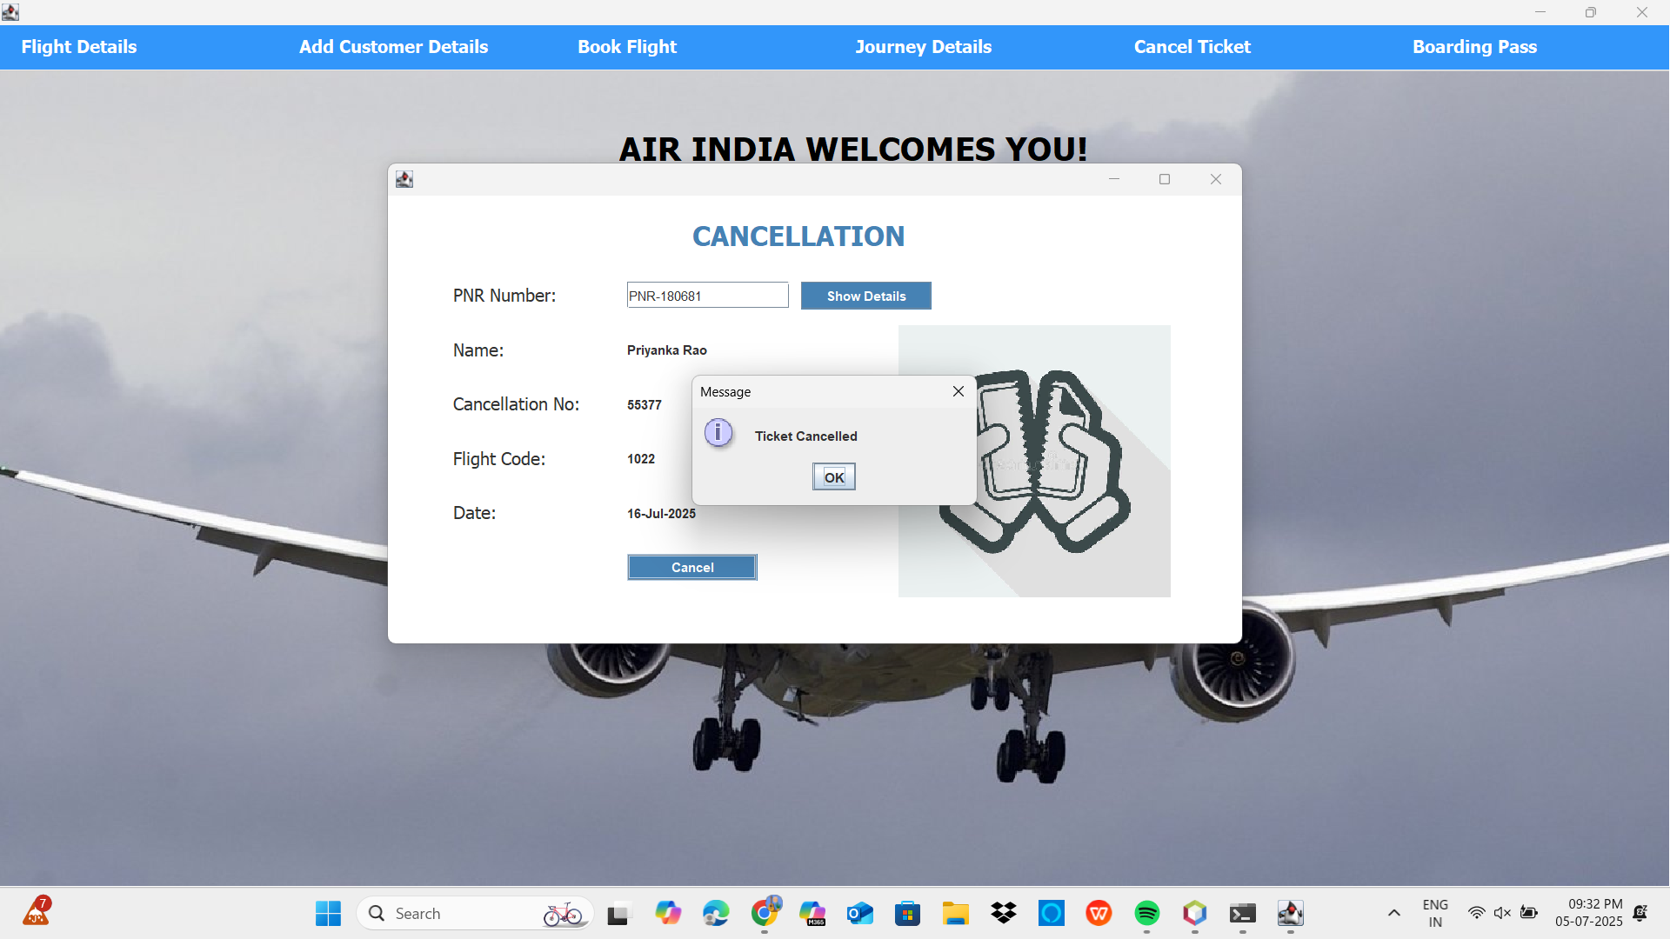

Slide 23
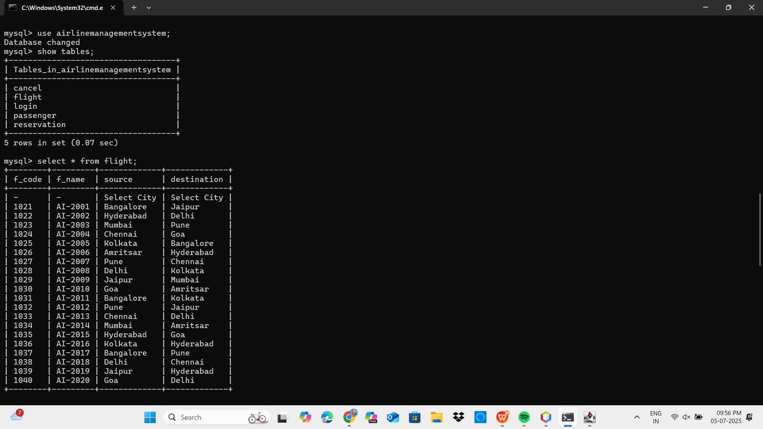

Slide 24
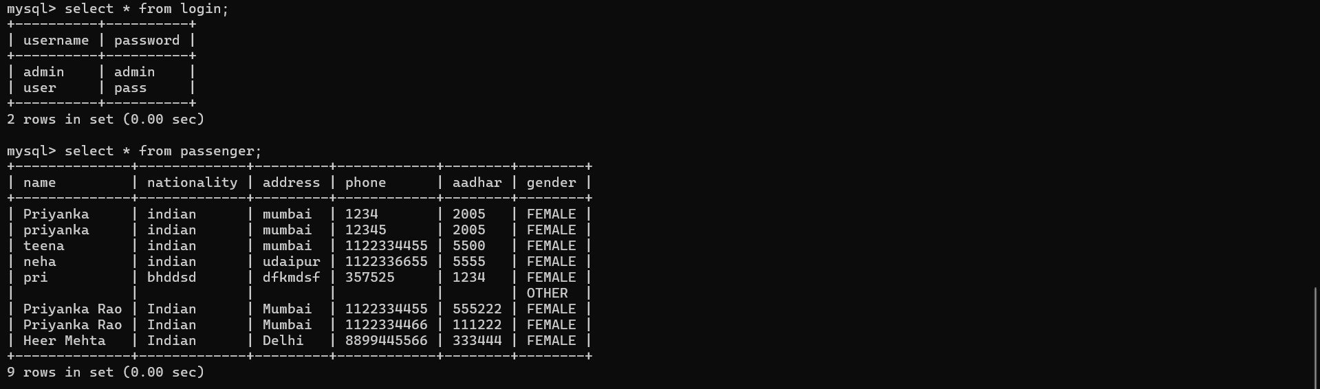

Slide 25
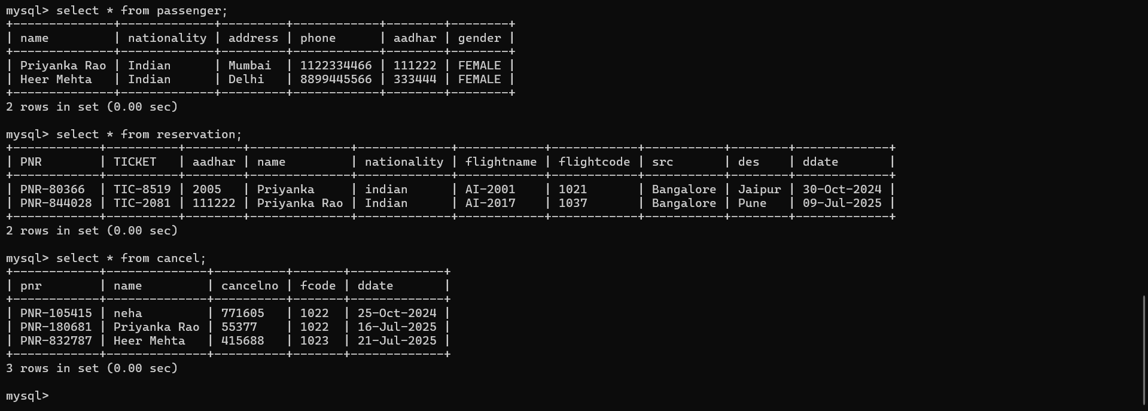

Slide 26
THE PROFESSIONAL TEMPLATE
THANKS

